Slide 1
Gen AI - Synthetic Data Services
Prepared for LOGIC

Slide 2
LOGIC’s Synthetic Data Services
Problem Statement:
Retail businesses often face challenges in generating sufficient data for training machine learning models, particularly for detecting valid and invalid transactions. The synthetic data will enhance the accuracy of ML models in identifying valid and invalid transactions, ultimately improving business operations and decision-making.
Goal:
Develop a website that allows users to upload an Excel file and generate synthetic data for retail applications. This synthetic data can be used to train ML models, improving their accuracy in detecting valid and invalid transactions.

Slide 3
LOGIC’s Synthetic Data Services
Approach:
1. Data Upload and Preprocessing:
- Users upload an Excel file containing retail transaction data.
- The data is pre-processed to remove any missing or invalid entries.
2. Data Filtering:
- Users can filter the data based on store number and other criteria.
- The filtered data is used for further processing.
3. Synthetic Data Generation:
- Users can choose to add noise to the data to simulate real-world scenarios.
- The tool uses Gaussian Copula Synthesizer to generate synthetic data based on the filtered data.
4. Data Visualization and Metrics:
- The tool provides visualizations to compare the original and synthetic data.
- Metrics are calculated to evaluate the quality of the synthetic data.

Slide 4
LOGIC’s Synthetic Data Services
Benefits:
1. Improved ML Model Accuracy:
- Synthetic data helps in training machine learning models, improving their accuracy in detecting valid and invalid transactions.
2. Data Privacy:
- Synthetic data generation ensures that sensitive customer information is not exposed.
3. Scalability:
- The tool can generate large amounts of data, making it suitable for various retail applications.
4. Flexibility:
- Users can customize the data generation process by adding noise and setting constraints.

Slide 5
LOGIC’s Synthetic Data Services
Tech Stack:
1. Python:
- Core programming language used for development.
2. Streamlit:
- Used for building the web interface for data upload and visualization.
3. SDV (Synthetic Data Vault):
- Used for generating synthetic data using Gaussian Copula Synthesizer.
4. Pandas:
- Used for data manipulation and preprocessing.
5. Plotly:
- Used for creating interactive visualizations.

Slide 6
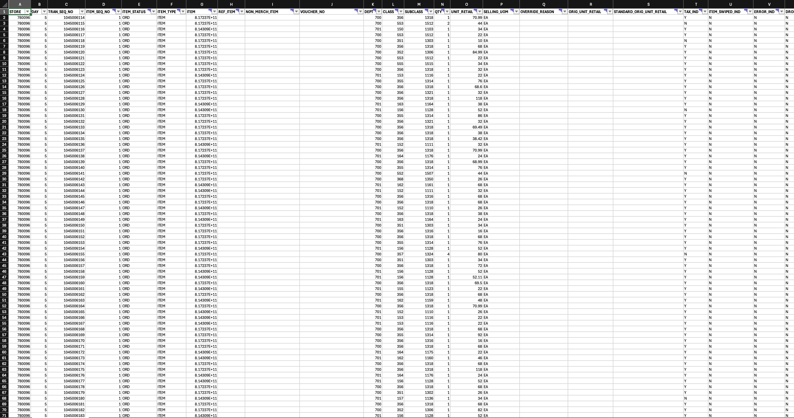
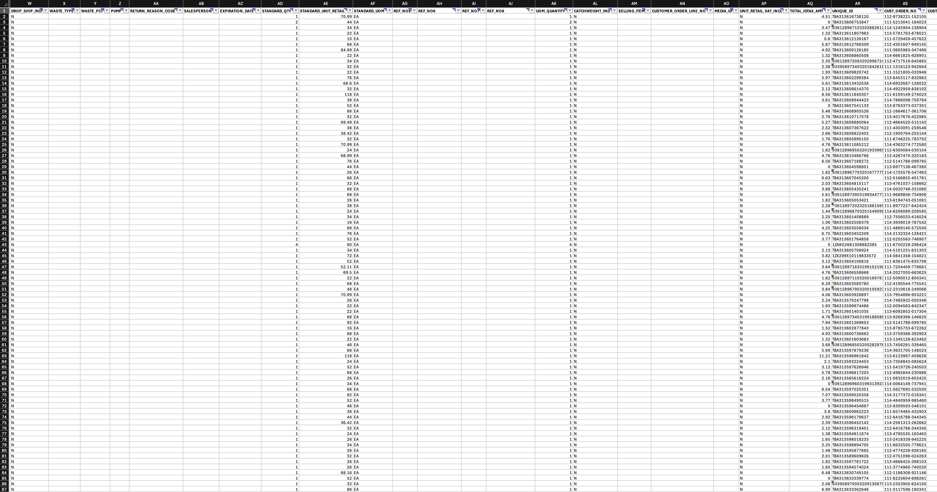
LOGIC’s Synthetic Data Services
Sample Screenshots
Format of the dataset used for development and testing

Slide 7
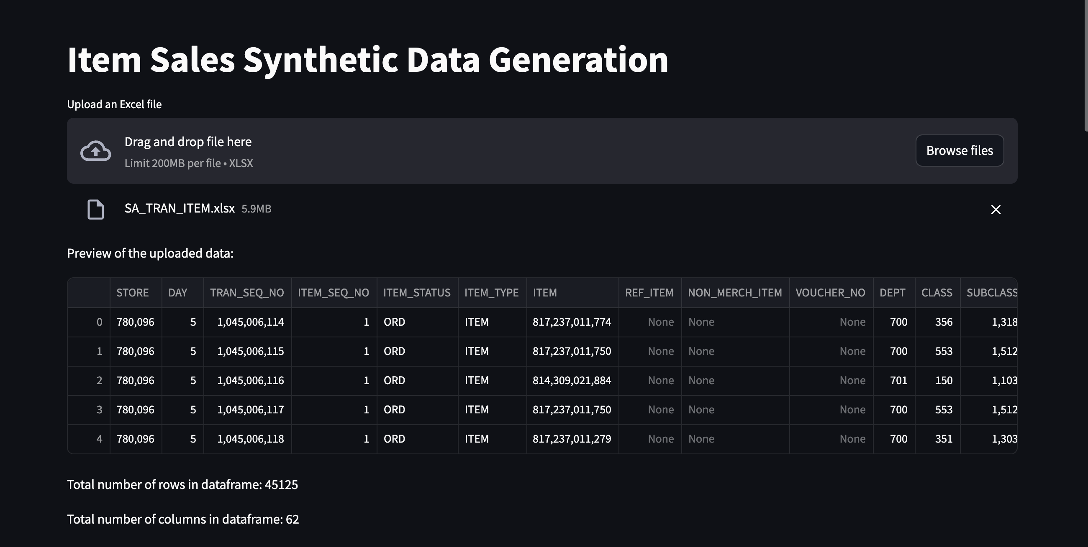
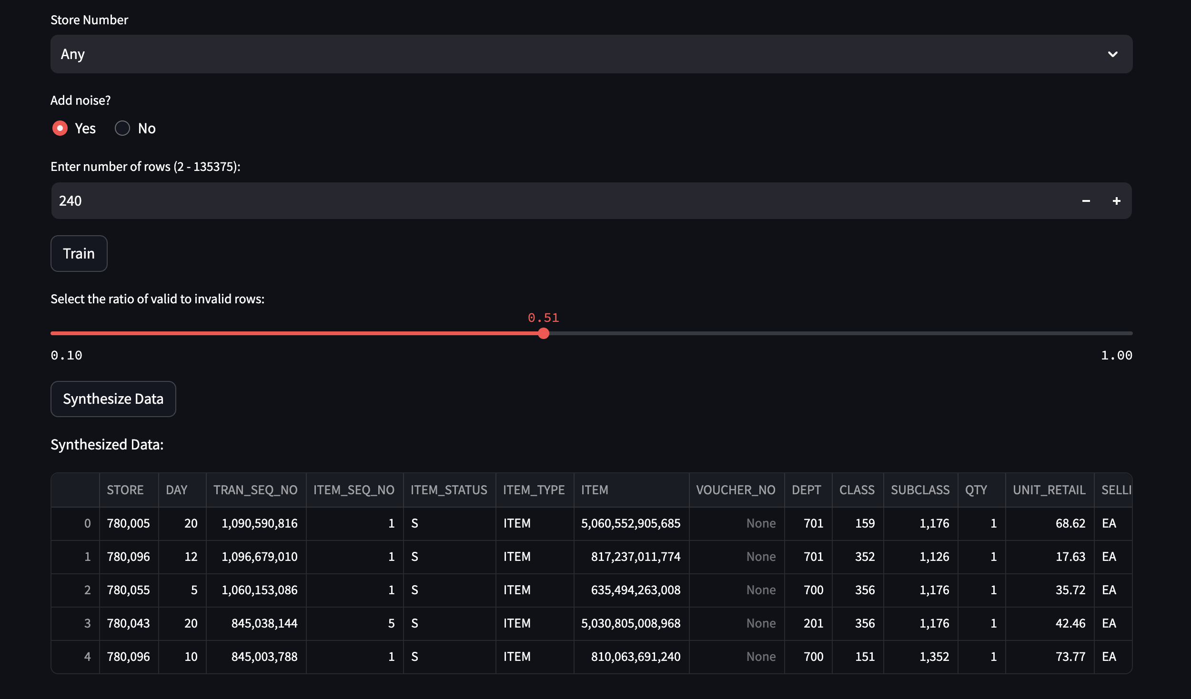
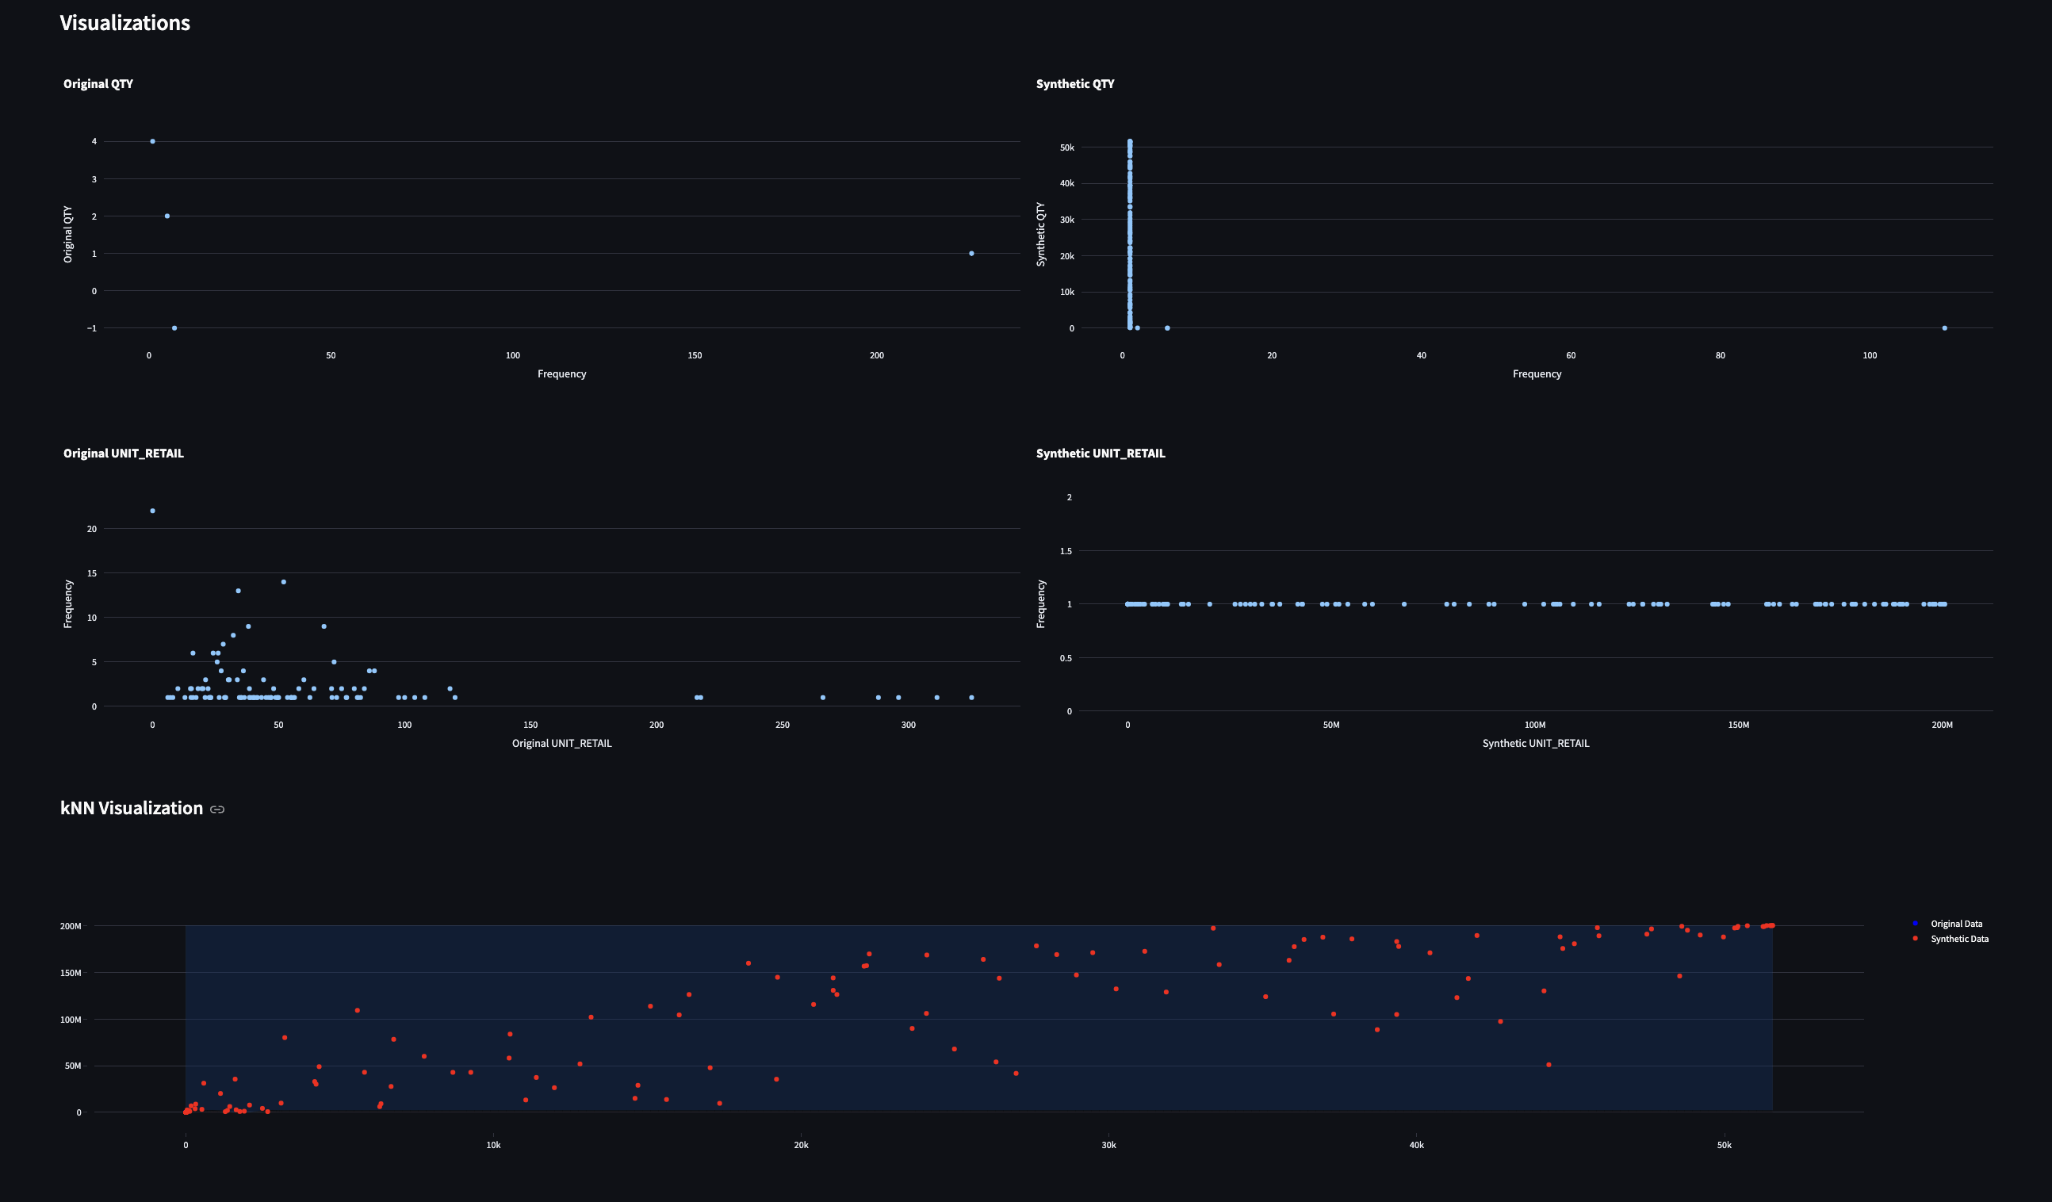
LOGIC’s Synthetic Data Services
Sample Screenshots

Slide 8
Thank you!!!

